Slide 1




Optimizing External Applications with HeuristicLab
A. Beham, M. Kommenda
Heuristic and Evolutionary Algorithms Laboratory (HEAL)
School of Informatics/Communications/Media, Campus Hagenberg
University of Applied Sciences Upper Austria

Slide 2


Instructor Biographies
Andreas Beham
Research Associate (since 2007)
Team: Combinatorial and Simulation-based Optimization
Graduate of Johannes Kepler University
PhD in progress
Member of the HEAL research group
Architect of HeuristicLab
http://heal.heuristiclab.com/team/beham
Michael Kommenda
Research Associate (since 2008)
Team: System Identification and Data Analysis
Graduate of University of Applied Sciences Upper Austria
PhD in progress
Member of the HEAL research group
Architect of HeuristicLab
http://heal.heuristiclab.com/team/kommenda

Slide 3
Latest Version of this Tutorial
An up-to-date version of this tutorial can be downloaded from the HeuristicLab website
http://dev.heuristiclab.com/trac.fcgi/browser/trunk/documentation/Tutorials

Slide 4
Agenda
Objectives of the Tutorial
Introduction
Where to get HeuristicLab?
Plugin Infrastructure
Graphical User Interface
Available Algorithms & Problems
Demonstration Part I: External Evaluation Problem
Demonstration Part II: MATLAB and Scilab Parameter Optimization Problem
Demonstration Part III: Programmable Problem
Some Additional Features
Planned Features
Team
Suggested Readings
Bibliography
Questions & Answers

Slide 5
Objectives of the Tutorial
Introduce general motivation and design principles of HeuristicLab
Show where to get HeuristicLab
Explain basic GUI usability concepts
Demonstrate basic features
Demonstrate optimization of parameters in external applications
Demonstrate optimization of parameters in MATLAB and Scilab
Demonstrate optimization of custom problem definitions
Outline some additional features

Slide 6
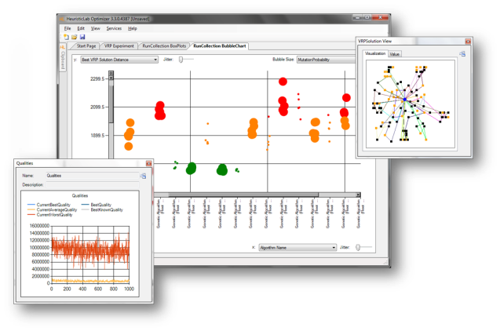
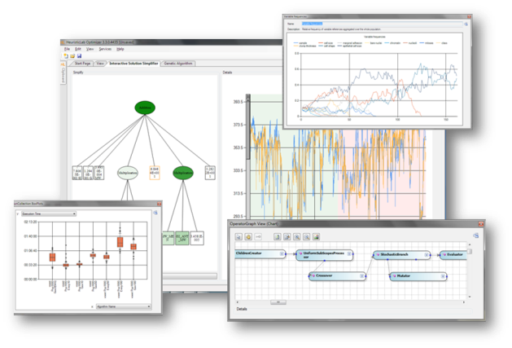

Introduction
Motivation and Goals
graphical user interface
paradigm independence
multiple algorithms and problems
large scale experiments and analyses
parallelization
extensibility, flexibility and reusability
visual and interactive algorithm development
multiple layers of abstraction
Facts
development of HeuristicLab started in 2002
based on Microsoft .NET and C#
used in research and education
second place at the Microsoft Innovation Award 2009
open source (GNU General Public License)
version 3.3.0 released on May 18th, 2010
latest version 3.3.10 "Vancouver" released on July 10th, 2014

Slide 7

Where to get HeuristicLab?
Download binaries
deployed as ZIP archives
latest stable version 3.3.10 "Vancouver"
released on July 10th, 2014
daily trunk builds
http://dev.heuristiclab.com/download
Check out sources
SVN repository
HeuristicLab 3.3.10 tag
http://svn.heuristiclab.com/svn/core/tags/3.3.10
Stable development version
http://svn.heuristiclab.com/svn/core/stable
License
GNU General Public License (Version 3)
System requirements
Microsoft .NET Framework 4.0 Full Version
enough RAM and CPU power ;-)

Slide 8
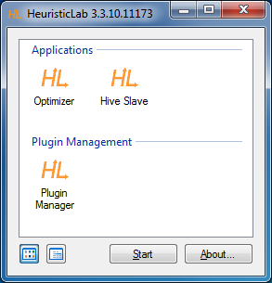
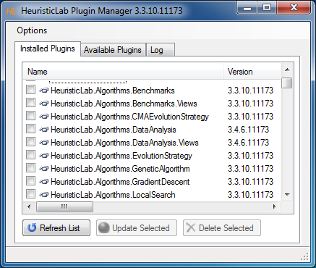
Plugin Infrastructure
HeuristicLab consists of many assemblies
142 plugins in HeuristicLab 3.3.10
plugins can be loaded or unloaded at runtime
plugins can be updated via internet
application plugins provide GUI frontends
Extensibility
developing and deploying new plugins is easy
dependencies are explicitly defined, automatically checked and resolved
automatic discovery of interface implementations (service locator pattern)
Plugin Manager
GUI to check, install, update or delete plugins

Slide 9
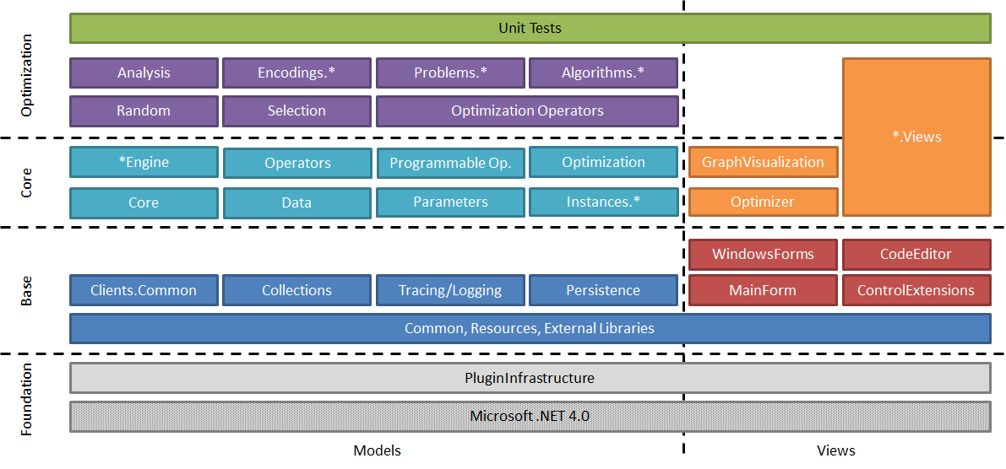
Plugin Architecture

Slide 10
Graphical User Interface
HeuristicLab GUI is made up of views
views are visual representations of content objects
views are composed in the same way as their content
views and content objects are loosely coupled
multiple different views may exist for the same content
Drag & Drop
views support drag & drop operations
content objects can be copied or moved (shift key)
enabled for collection items and content objects

Slide 11
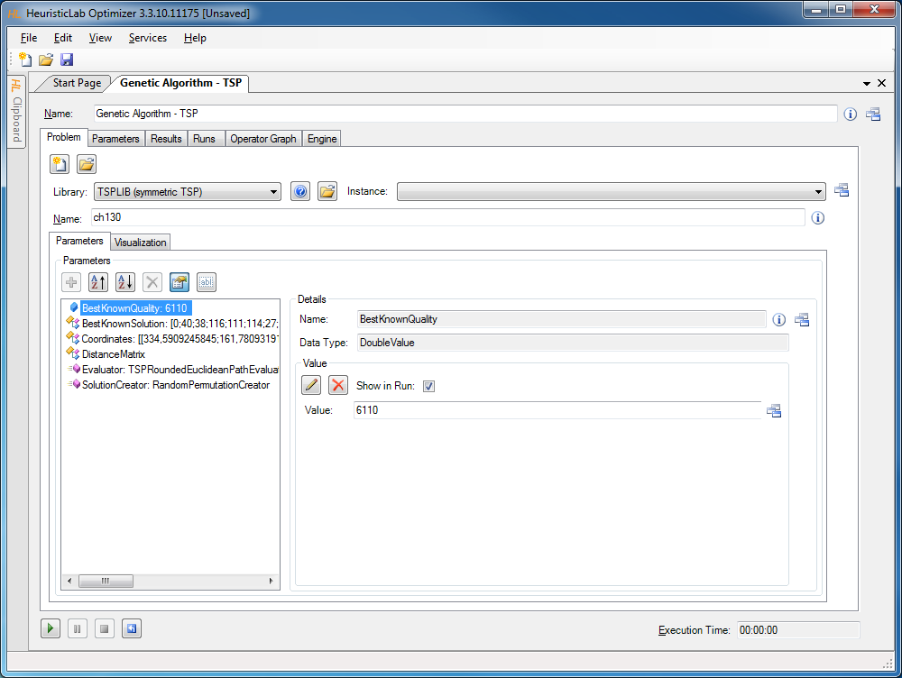
Graphical User Interface
Algorithm View
Problem View
Parameter Collection View
Parameter View
Double Value View

Slide 12
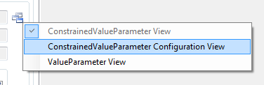
Graphical User Interface
ViewHost
control which hosts views
right-click on windows icon to switch views
double-click on windows icon to open another view
drag & drop windows icon to copy contents

Slide 13
Available Algorithms
Population-based
CMA-ES
Evolution Strategy
Genetic Algorithm
Offspring Selection Genetic Algorithm
Island Genetic Algorithm
Island Offspring Selection Genetic Algorithm
SASEGASA
Relevant Alleles Preserving GA (RAPGA)
Genetic Programming
NSGA-II
Scatter Search
Particle Swarm Optimization
Trajectory-based
Local Search
Tabu Search
Robust Taboo Search
Variable Neighborhood Search
Simulated Annealing
Data Analysis
Linear Discriminant Analysis
Linear Regression
Multinomial Logit Classification
k-Nearest Neighbor
k-Means
Neighbourhood Component Analysis
Artificial Neural Networks
Random Forests
Support Vector Machines
Gaussian Processes
Additional Algorithms
User-defined Algorithm
Performance Benchmarks
Hungarian Algorithm
Cross Validation
LM-BFGS

Slide 14
Available Problems
Combinatorial Problems
Traveling Salesman
Vehicle Routing
Knapsack
Job Shop Scheduling
Linear Assignment
Quadratic Assignment
OneMax
Genetic Programming Problems
Symbolic Classification
Symbolic Regression
Symbolic Time-Series Prognosis
Artificial Ant
Lawn Mower
Additional Problems
Single-Objective Test Function
User-defined Problem
External Evaluation Problem (Anylogic, Scilab, MATLAB)
Regression, Classification, Clustering
Trading
Grammatical Evolution

Slide 15
Agenda
Objectives of the Tutorial
Introduction
Where to get HeuristicLab?
Plugin Infrastructure
Graphical User Interface
Available Algorithms & Problems
Demonstration Part I: External Evaluation Problem
Demonstration Part II: MATLAB and Scilab Parameter Optimization Problem
Demonstration Part III: Programmable Problem
Some Additional Features
Planned Features
Team
Suggested Readings
Bibliography
Questions & Answers

Slide 16
Demonstration Part I: External Evaluation Problem
Optimize parameters of an existing simulation model
Implement necessary steps to talk with HeuristicLab

Slide 17
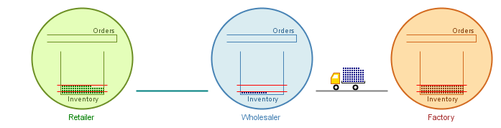
Supply Chain Simulation
(s, S) Order Policy
3 Echelons and 2 Parameters per Echelon
Minimize Inventory and Ordering Costs
Maintain a minimum service level
Bound on the waiting time due to „out of stock“ situations

Slide 18
Supply Chain Simulation
Create a new simulation experiment for evaluating parameters from HeuristicLab
Create the problem definition in HeuristicLab
Optimize

Slide 19
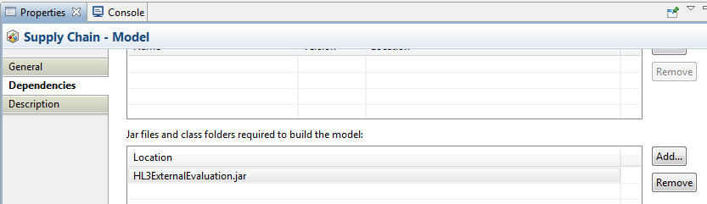
Supply Chain Simulation
Download communication helper library
http://dev.heuristiclab.com/trac.fcgi/wiki/Documentation/Howto/OptimizeExternalApplications#no1
Add library as dependency to the model

Slide 20
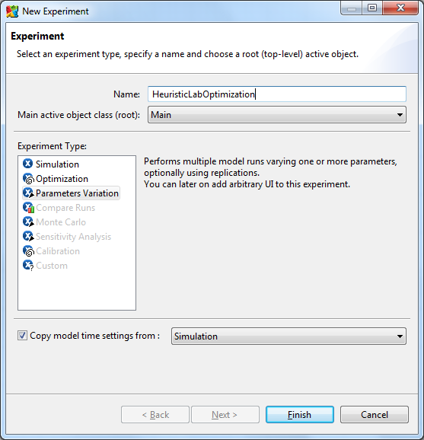
Supply Chain Simulation
The model is included as a sample in AnyLogic
Open the model and create a new experiment of type „Parameters Variation“

Slide 21
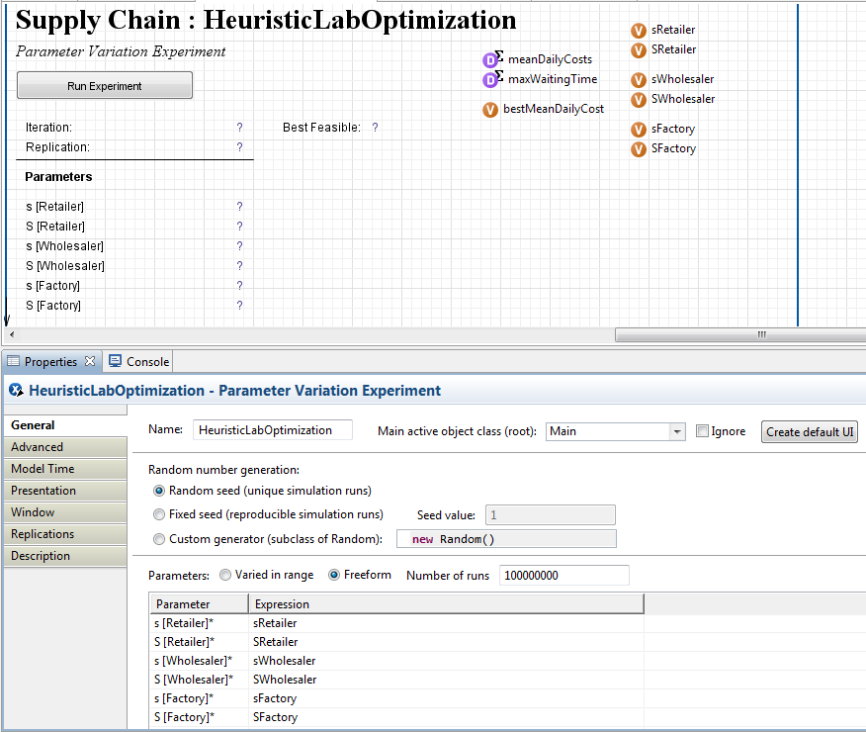
Supply Chain Simulation
Configure the experiment
Create the default user interface by clicking the button
Add one variable for each parameter and add statistics for collecting quality relevant information over multiple replications
Select to vary parameters Freeform, use an arbitrary, but high number of runs and specify the variable that is assigned to each parameter
Optional: remember the best identified solution so far
2
1
3

Slide 22
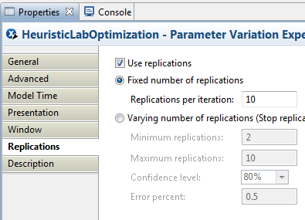
Supply Chain Simulation
Switch to the Replications tab
Check the box „Use replications“
Use a fixed number of 10 replications

Slide 23
Supply Chain Simulation
How do parameter variation experiments work in AnyLogic?
In an experiment run there are N iterations
In each iteration R runs execute
N = „Number of runs“ on the General tab
R = „Replications per iteration“

Slide 24
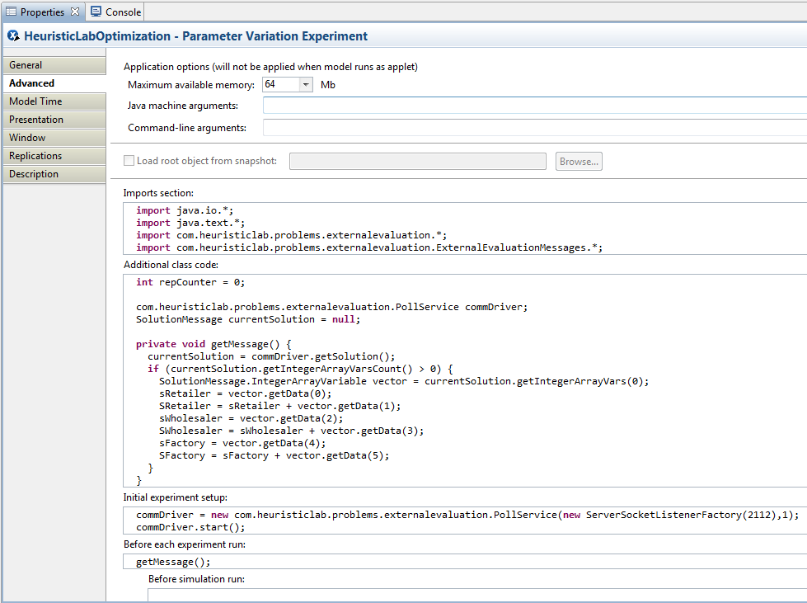
Supply Chain Simulation
Switch to the Advanced tab, here we need to enter some code
Initialize the communication
Receive parameters from HeuristicLab
Collect statistics after each run
Send back the averaged results and continue with step 2

Slide 25
Supply Chain Simulation
Imports section:
Additional class code:
import java.io.*;
import java.text.*;
import com.heuristiclab.problems.externalevaluation.*;
import com.heuristiclab.problems.externalevaluation.ExternalEvaluationMessages.*;
com.heuristiclab.problems.externalevaluation.PollService commDriver;
SolutionMessage currentSolution = null;
private void getMessage() {
currentSolution = commDriver.getSolution();
if (currentSolution.getIntegerArrayVarsCount() > 0) {
SolutionMessage.IntegerArrayVariable vector = currentSolution.getIntegerArrayVars(0);
sRetailer = vector.getData(0);
SRetailer = sRetailer + vector.getData(1);
sWholesaler = vector.getData(2);
SWholesaler = sWholesaler + vector.getData(3);
sFactory = vector.getData(4);
SFactory = sFactory + vector.getData(5);
}
}

Slide 26
Supply Chain Simulation
Initial experiment setup:
Before each experiment run:
After simulation run:
commDriver = new com.heuristiclab.problems.externalevaluation.PollService(new ServerSocketListenerFactory(2112),1);
commDriver.start();
getMessage();
meanDailyCosts.add(root.meanDailyCost());
maxWaitingTime.add(root.histWaitingTime.max());

Slide 27
Supply Chain Simulation
After iteration:
double fitness = 0;
Boolean isFeasible = maxWaitingTime.max() < 0.001;
if (isFeasible) {
fitness = meanDailyCosts.mean();
if (meanDailyCosts.mean() < bestMeanDailyCost)
bestMeanDailyCost = meanDailyCosts.mean();
} else {
fitness = 2000 + maxWaitingTime.max();
}
try {
commDriver.sendQuality(currentSolution, fitness);
} catch (IOException e) { /* handle error */ }
meanDailyCosts.reset();
maxWaitingTime.reset();
getMessage();

Slide 28
Supply Chain Simulation
Create a new simulation experiment for evaluating parameters from HeuristicLab
Create the problem definition in HeuristicLab
Optimize

Slide 29
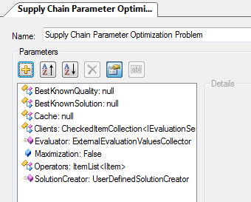
Supply Chain Simulation
Cache: optional parameter is only used in conjunction with the cached evaluator
Clients: the simulation model instances that can evaluate parameters
Evaluator: The operator that will extract the parameters and transmit them to the model
Maximization: Whether the returned fitness is to be minimized or maximized
Operators: The list of solution manipulation and analysis operators that are used by the algorithm
SolutionCreator: The operator that will construct the initial solutions

Slide 30
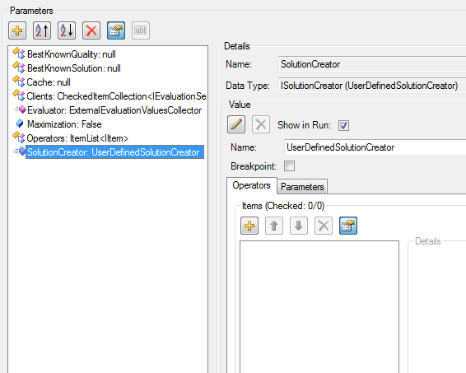
Supply Chain Simulation
Click on the SolutionCreator parameter
Click on the pencil icon to choose a new solution creator

Slide 31
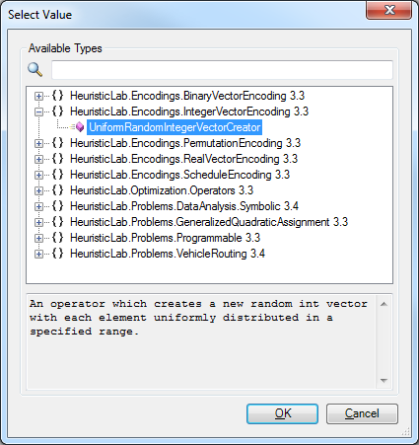
Supply Chain Simulation
Select the UniformRandomIntegerVectorCreator from the list of available types
Click OK

Slide 32
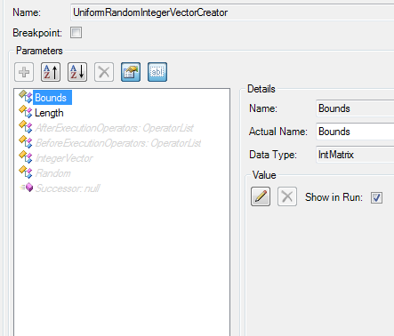
Supply Chain Simulation
Click to show hidden parameters
This creator exposes several parameters that need to be defined
Bounds: An IntMatrix
Length: An IntValue
IntegerVector: A parameter that denotes the name of the solution
1
3
2

Slide 33
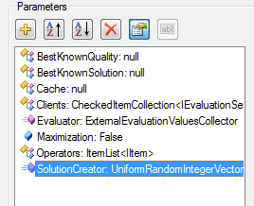
Supply Chain Simulation
Create those parameters as part of the problem
Other operators might also need to access the bounds
1

Slide 34
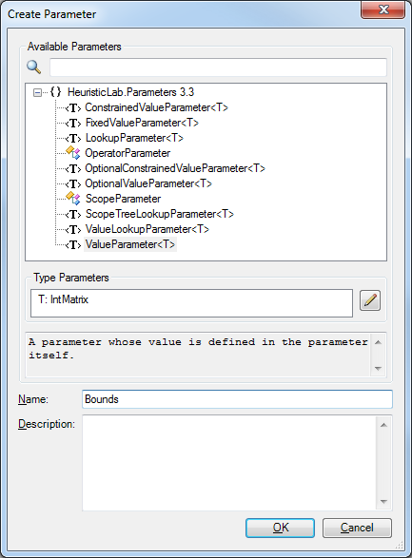
Supply Chain Simulation
Create a new parameter
Choose the parameter kind (ValueParameter, LookupParameter, etc.)
Set the type of the value (e.g. IntMatrix)
Choose a name and optionally a description
1
3
2
4

Slide 35
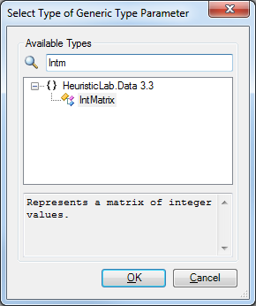
Supply Chain Simulation
When choosing the type for the value use the search box to find the correct type

Slide 36
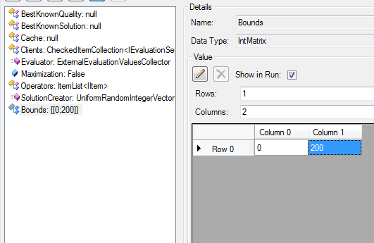
Supply Chain Simulation
Click on the newly created parameter
Set Rows to 1, set Columns to 2 and insert 0 and 200 into the matrix
This will be the lower and upper bound for each dimension in the vector
If you have less rows in the bounds than dimensions in the vector, the bounds will be cycled

Slide 37

Supply Chain Simulation
Define another ValueParameter<T> of type IntValue and call it Length
Click OK

Slide 38
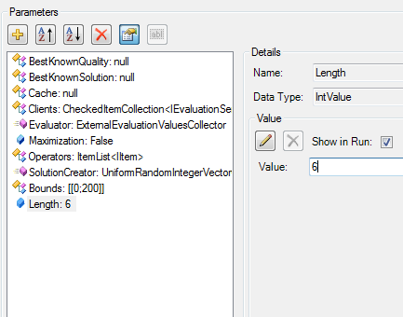
Supply Chain Simulation
Set the value of the Length parameter to 6

Slide 39
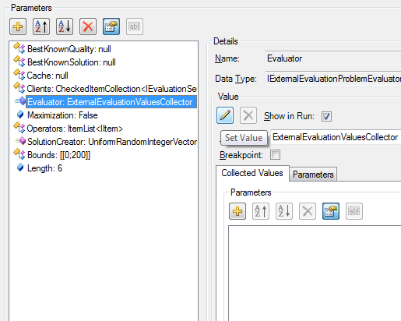
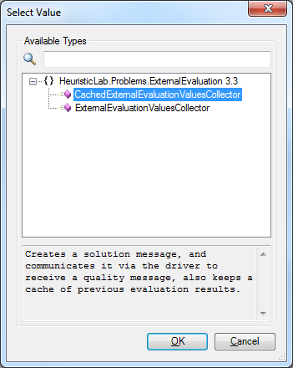
Supply Chain Simulation
Next change the evaluator to make use of the cache
Click on the Evaluator parameter
Click on the pencil icon
Choose the CachedExternalEvaluationValuesCollector

Slide 40
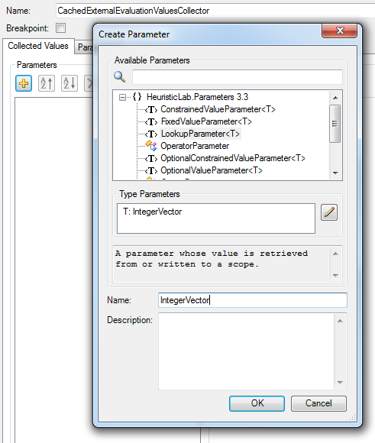
Supply Chain Simulation
On the Collected Values tab, click to add a LookupParameter<T> with T being an IntegerVector and call it „IntegerVector“
The evaluator will look for this data and transmit it to the simulation model
1
3
2
4

Slide 41
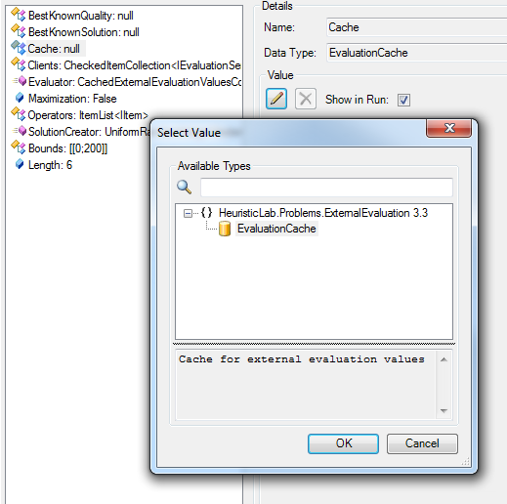
Supply Chain Simulation
Click on the Cache parameter
Click on the pencil icon to assign a value
A dialog will pop up
In the dialog select the EvaluationCache
Click Ok
1
2
3

Slide 42
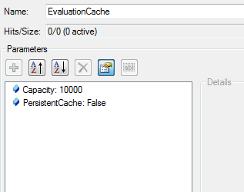
Supply Chain Simulation
The cache will store the solution message and the returned quality
New solution messages will be compared against those already inside the cache
The capacity of the cache can be adjusted
PersistentCache determines if the cache should be stored when the problem or algorithm is saved

Slide 43
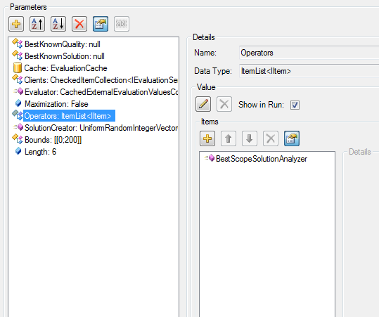
Supply Chain Simulation
Let‘s add some operators that algorithms can use to manipulate the solution
Click on the Operators parameter
Click on the + icon to add some operators
1
2

Slide 44
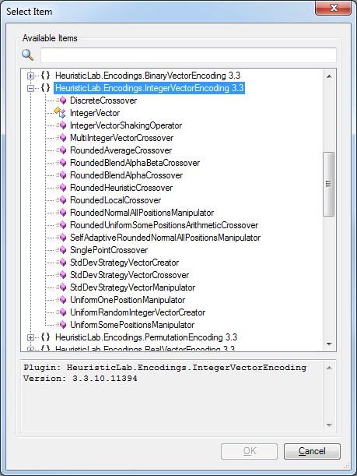
Supply Chain Simulation
Valid operators are those inside the plugin HeuristicLab.Encodings.IntegerVectorEncoding
Create a RoundedBlendAlphaBetaCrossover
Then add a UniformSomePositionsManipulator to the list of operators

Slide 45
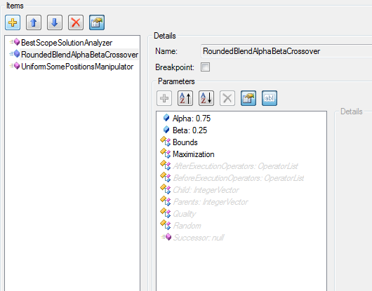
Supply Chain Simulation
Check the parameters and hidden parameters of the operators that you have added
The names must match parameters that you have already defined
If the names do not match, adjust the ActualName of the parameter
Provided by
the Evaluator

Slide 46
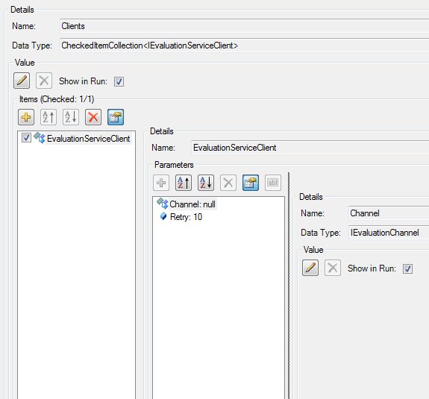
Supply Chain Simulation
Now set up the client machine that runs the simulation model
Click on the Client parameter
Click on EvaluationServiceClient
Click on the Channel parameter
Click the pencil icon to set a new channel

Slide 47
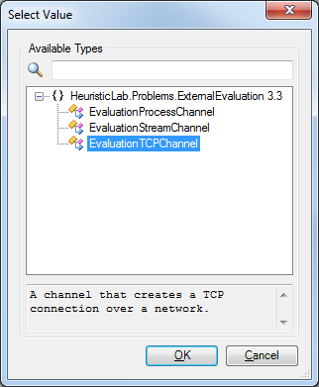
Supply Chain Simulation
Select the EvaluationTCPChannel for communicating over a TCP/IP connection
Click OK

Slide 48
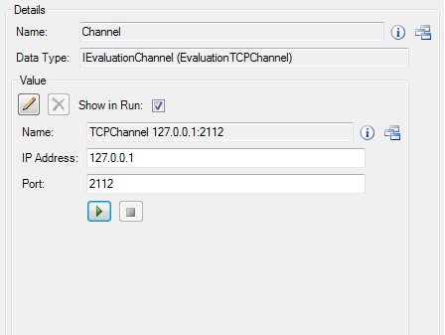
Supply Chain Simulation
Enter the IP address of the machine that the models runs on, use 127.0.0.1 if the model runs on the same machine
We configured our model to listen on port 2112 so we enter this information as Port

Slide 49
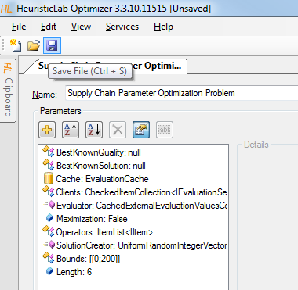
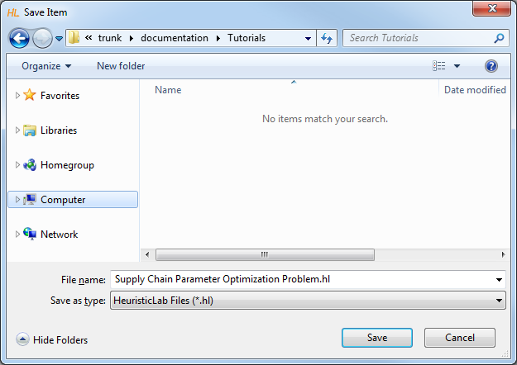
Supply Chain Simulation
The problem is now configured
Click the save button to store the external problem definition into a file

Slide 50
Supply Chain Simulation
Create a new simulation experiment for evaluating parameters from HeuristicLab
Create the problem definition in HeuristicLab
Optimize

Slide 51
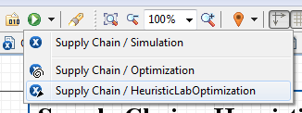
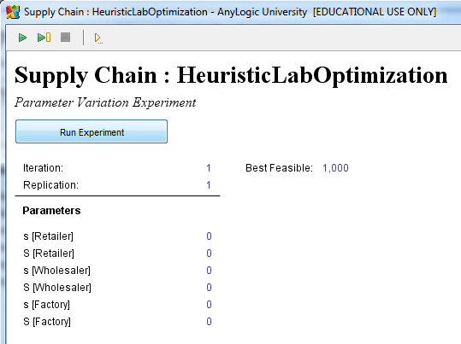
Supply Chain Simulation
In AnyLogic click the arrow next to the green play button and select our newly created experiment
Click to run the experiment at which point the model will wait to receive a solution message
1
2

Slide 52
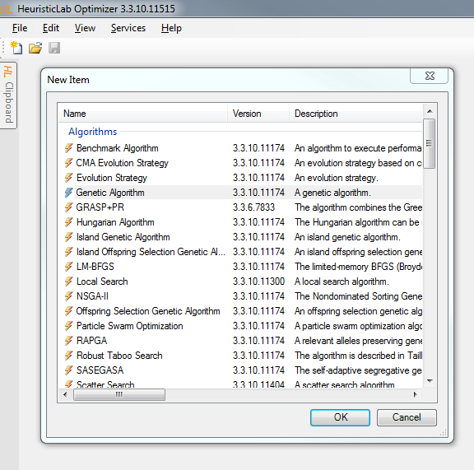
Supply Chain Simulation
In HeuristicLab click on the „New Item“ button to open the list of creatable items
Select the Genetic Algorithm entry
Click OK

Slide 53
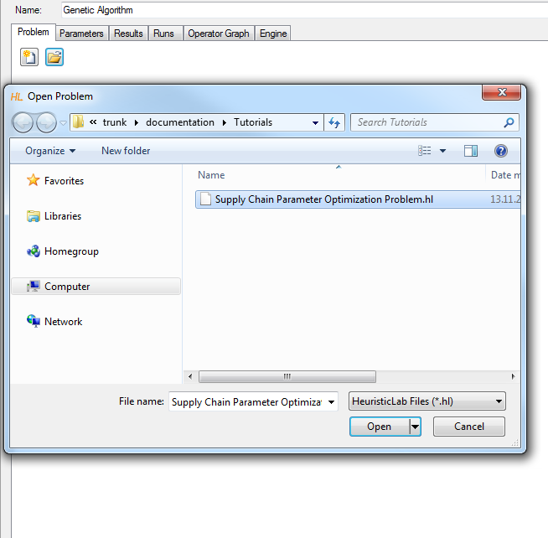
Supply Chain Simulation
Click on the Open button and select the previously saved problem definition
Click Open in the dialog

Slide 54
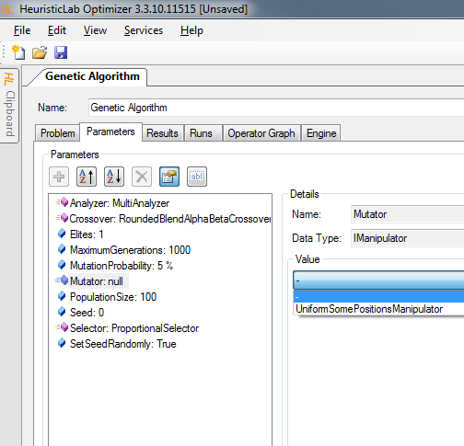
Supply Chain Simulation
Click on the Mutator parameter
Select the manipulator that we have added to the operators list in one of the previous steps
Switch to the Results tab and hit the play button at the bottom

Slide 55
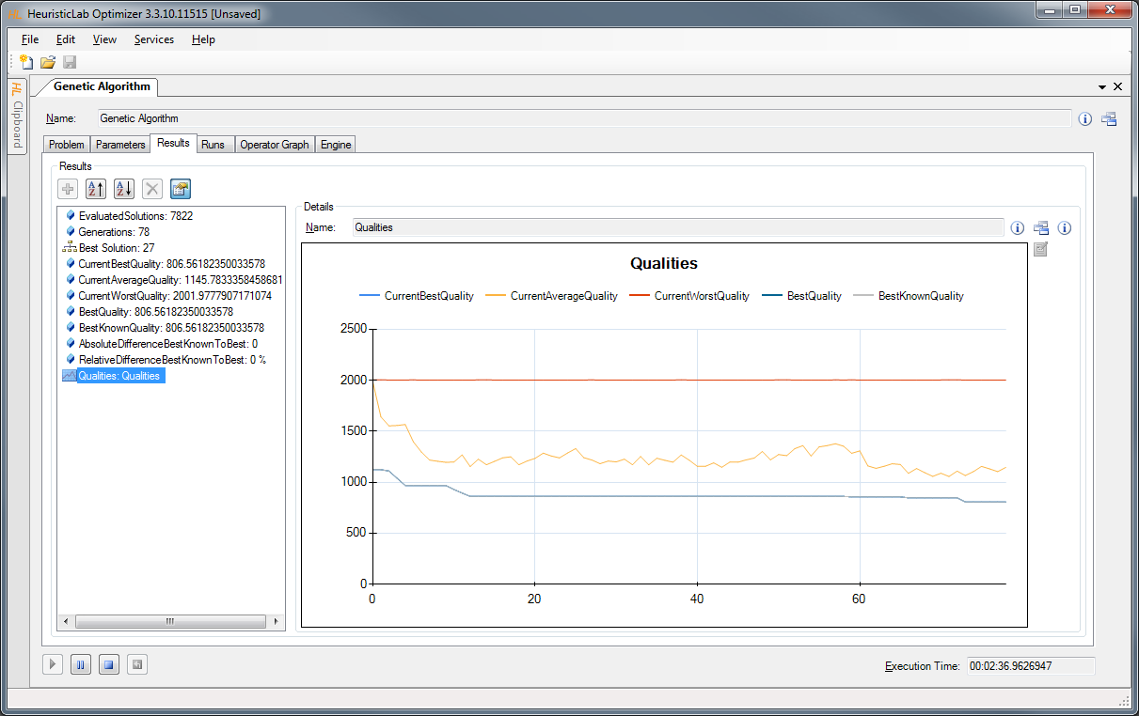
Supply Chain Simulation

Slide 56
Agenda
Objectives of the Tutorial
Introduction
Where to get HeuristicLab?
Plugin Infrastructure
Graphical User Interface
Available Algorithms & Problems
Demonstration Part I: External Evaluation Problem
Demonstration Part II: MATLAB and Scilab Parameter Optimization Problem
Demonstration Part III: Programmable Problem
Some Additional Features
Planned Features
Team
Suggested Readings
Bibliography
Questions & Answers

Slide 57
Demonstration Part II: Parameter Optimization Problem
Parameter Optimization of Differential Equation Systems (Scilab)

Slide 58
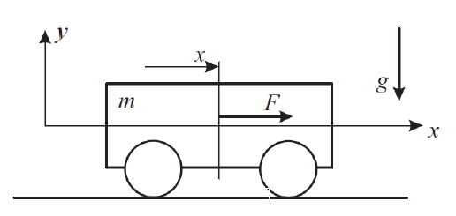
Electric cart simulation
Identify unknown parameter values of a simulation model
Measure movements of an electric cart with known power
Adapt parameters of an simulation model to match those measurements

Slide 59
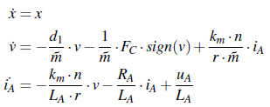
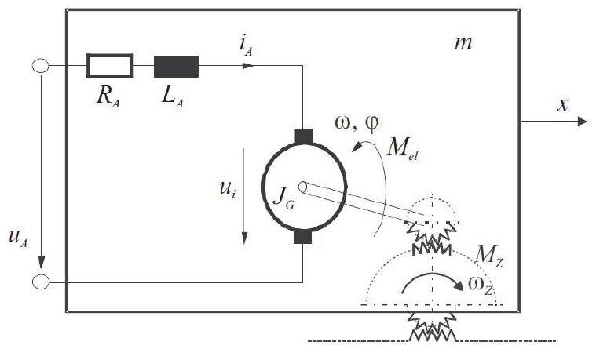
Electric cart simulation
Identify friction coefficients d₁, F_{C} and mass m
Voltage u_{A} and initial values for position x, velocity v and amperage i_{A} are known
Simulate changes according to differential equations

Slide 60
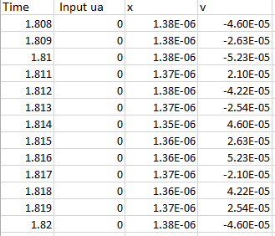
Measurements

Slide 61
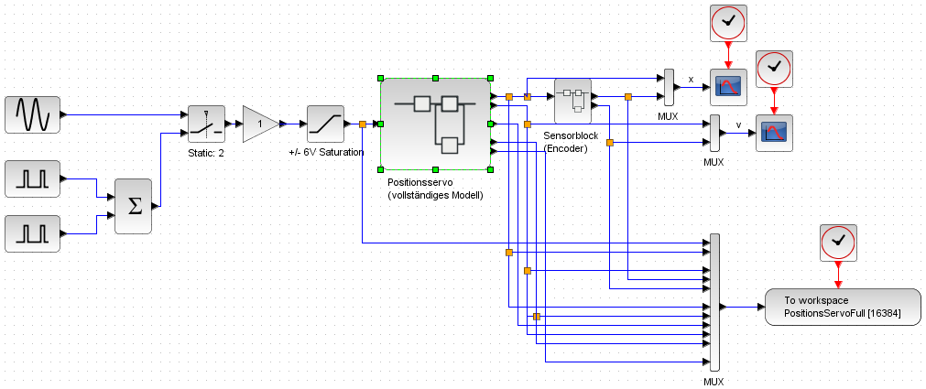
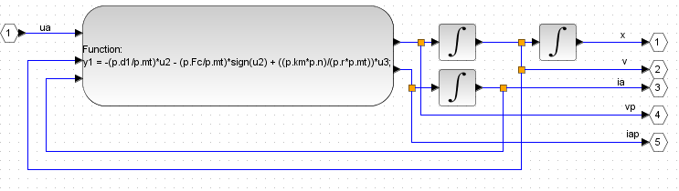
Simulation in Scilab

Slide 62
Parameter Optimization
Create a new Scilab parameter optimization problem in HeuristicLab
Configure the problem with your scripts in HeuristicLab
Optimize

Slide 63
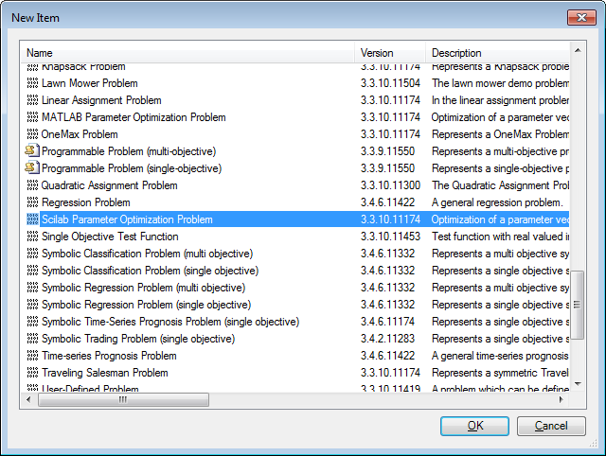
Parameter Optimization

Slide 64
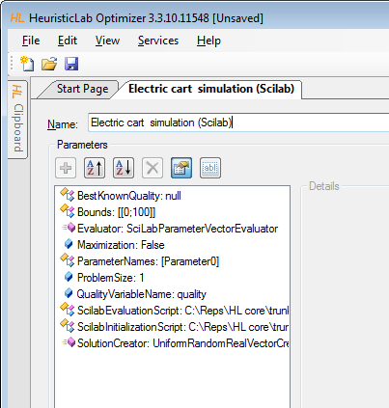
Parameter Optimization
Specify path to Scilab scripts
Initialization script
Evaluation script

Slide 65
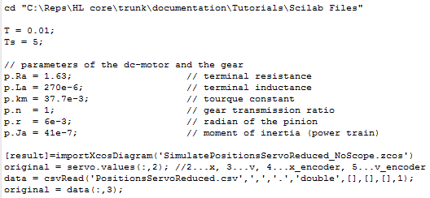
Initialization Script
Sets constants and time intervals
Loads the simulation model
Reads the measured values from a csv file

Slide 66

Evaluation Script
Configures and runs the simulation with values from HeuristicLab
Calculates quality as sum of absolute errors between simulated and measured values

Slide 67

Parameter Optimization
Configure problem size
Configure parameter names
Parameter names are created as variables in Scilab
Adapt bounds

Slide 68

Parameter Optimization
Create CMA-ES
Drop problem on algorithm

Slide 69

Parameter Optimization
Configure algorithm
Initial Sigma 1.0
Maximum Generations 50
Enable CMAAnalzer

Slide 70

Parameter Optimization
Optimal values (m = 1.5, d1 = 1, FC = 0.5)

Slide 71


Parameter Optimization

Slide 72
Agenda
Objectives of the Tutorial
Introduction
Where to get HeuristicLab?
Plugin Infrastructure
Graphical User Interface
Available Algorithms & Problems
Demonstration Part I: External Evaluation Problem
Demonstration Part II: MATLAB and Scilab Parameter Optimization Problem
Demonstration Part III: Programmable Problem
Some Additional Features
Planned Features
Team
Suggested Readings
Bibliography
Questions & Answers

Slide 73
Demonstration Part III: Programmable Problem
Singleobjective Function Optimization
Multiobjective Function Optimization

Slide 74
Programmable Problem
Still under development
Currently available as a feature branch
http://dev.heuristiclab.com/trac.fcgi/browser/branches/ProgrammableProblem
Planned to release with 3.3.11 (Feb. 2015)

Slide 75

Singleobjective Function Opt.
Click on „New Item“ to get a list of creatables
Create a new Programmable Problem (single-objective) by double clicking it

Slide 76

Singleobjective Function Opt.
C# Editor for Writing the Problem Definition

Slide 77


Singleobjective Function Opt.
Styblinski-Tang function:
$$f\left(x\right)=\frac{\sum_{i=1}^{n}{x_{i}^{4}−16x_{i}^{2}+5x_{i}}}{2}$$
with $−5≤x_{i}≤5$

Slide 78
Singleobjective Function Opt.
Choose an appropriate solution encoding
20-dimensional real-valued vector
Minimize the fitness value
public bool IsMaximizationProblem { get { return false; } }
public CustomProblemDefinition() {
// Define the solution encoding which can also consist of multiple vectors, examples below
// Encoding = new BinaryEncoding("b", length: 5);
// Encoding = new IntegerEncoding("i", lenght: 5, min: 2, max: 14, step: 4);
Encoding = new RealEncoding("vector", length: 20, min: -5.0, max: 5.0);
// Encoding = new PermutationEncoding("P", length: 5, type: PermutationTypes.Absolute);
// Encoding = new MultiEncoding()
// .AddBinaryVector("b", length: 5)
// .AddIntegerVector("i", length: 5, min: 2, max: 14, step: 4)
// .AddRealVector("r", length: 5, min: -1.0, max: 1.0)
// .AddPermutation("P", length: 5, type: PermutationTypes.Absolute)
;
}

Slide 79
Singleobjective Function Opt.
Define the fitness function
public double Evaluate(IRandom random, Individual individual) {
var vector = individual.RealVector("vector");
return vector.Sum(x => x * x * x * x - 16.0 * x * x + 5 * x) / 2.0;
}

Slide 80

Singleobjective Function Opt.
Compile the problem defintion

Slide 81

Singleobjective Function Opt.
Create a suitable optimization algorithm
Select CMA Evolution Strategy
Click OK

Slide 82

Singleobjective Function Opt.
Drag‘n‘Drop

Slide 83

Singleobjective Function Opt.
Switch to the Parameters tab
Click on the Analyzer parameter
Check CMAAnalyzer to get more detailed results
1
2

Slide 84

Singleobjective Function Opt.
Choose suitable parameters
InitialSigma: 2
MaximumGenerations: 200
PopulationSize: 50

Slide 85

Singleobjective Function Opt.

Slide 86


Multiobjective Function Opt.
Fonseca and Fleming function:
$$\text{Minimize}= \left\{\begin{matrix}f_{1}\left(x\right)=1−e^{−\sum_{i=1}^{n}{{(x_{i} − \frac{1}{\sqrt{n}})}^{2}}} \\ f_{2}\left(x\right)=1−e^{−\sum_{i=1}^{n}{{(x_{i} + \frac{1}{\sqrt{n}})}^{2}}}\end{matrix}\right.$$
with $−4≤x≤4$

Slide 87
Multiobjective Function Opt.
Click on „New Item“ to get a list of creatables
Create a new Programmable Problem (multi-objective) by double clicking it

Slide 88
Multiobjective Function Opt.
Choose an appropriate solution encoding
10-dimensional real-valued vector
Minimize all fitness values
public bool[] Maximization { get { return new [] { false, false }; } }
public CustomProblemDefinition() {
// Define the solution encoding which can also consist of multiple vectors, examples below
// Encoding = new BinaryEncoding("b", length: 5);
// Encoding = new IntegerEncoding("i", lenght: 5, min: 2, max: 14, step: 4);
Encoding = new RealEncoding("vector", length: 10, min: -4.0, max: 4.0);
// Encoding = new PermutationEncoding("P", length: 5, type: PermutationTypes.Absolute);
// Encoding = new MultiEncoding()
// .AddBinaryVector("b", length: 5)
// .AddIntegerVector("i", length: 5, min: 2, max: 14, step: 4)
// .AddRealVector("r", length: 5, min: -1.0, max: 1.0)
// .AddPermutation("P", length: 5, type: PermutationTypes.Absolute)
;
}

Slide 89
Multiobjective Function Opt.
Define the fitness functions
public double[] Evaluate(IRandom random, Individual individual) {
var qualities = new double[2];
var vector = individual.RealVector("vector");
var n = vector.Length;
qualities[0] = 1.0 - Math.Exp(- vector.Sum(x => Math.Pow(x - 1.0/Math.Sqrt(n), 2)));
qualities[1] = 1.0 - Math.Exp(- vector.Sum(x => Math.Pow(x + 1.0/Math.Sqrt(n), 2)));
return qualities;
}

Slide 90

Multiobjective Function Opt.
Compile the problem defintion

Slide 91

Multiobjective Function Opt.
Create a suitable optimization algorithm
Select NSGA-II
Click OK

Slide 92

Multiobjective Function Opt.
Drag‘n‘Drop

Slide 93

Multiobjective Function Opt.
Adjust the parameters
Set Crossover: SBX
Set Mutator: Polynomial

Slide 94


Multiobjective Function Opt.

Slide 95
Agenda
Objectives of the Tutorial
Introduction
Where to get HeuristicLab?
Plugin Infrastructure
Graphical User Interface
Available Algorithms & Problems
Demonstration Part I: External Evaluation Problem
Demonstration Part II: MATLAB and Scilab Parameter Optimization Problem
Demonstration Part III: Programmable Problem
Some Additional Features
Planned Features
Team
Suggested Readings
Bibliography
Questions & Answers

Slide 96

Some Additional Features
HeuristicLab Hive
parallel and distributed execution of algorithms and experiments on many computers in a network
Optimization Knowledge Base (OKB)
database to store algorithms, problems, parameters and results
open to the public
open for other frameworks
analyze and store characteristics of problem instances and problem classes
External solution evaluation and simulation-based optimization
interface to couple HeuristicLab with other applications (MATLAB, Simulink, SciLab, AnyLogic, …)
supports different protocols (command line parameters, TCP, …)
Parameter grid tests and meta-optimization
automatically create experiments to test large ranges of parameters
apply heuristic optimization algorithms to find optimal parameter settings for heuristic optimization algorithms

Slide 97
Planned Features
Algorithms & Problems
steady-state genetic algorithm
unified tabu search for vehicle routing
estimation of distribution algorithms
evolution of arbitrary code (Robocode, controller, etc.)
…
Cloud Computing
port HeuristicLab Hive to Windows Azure
Statistics
implement statistical tests and automated statistical analysis
Have a look at the HeuristicLab roadmap
http://dev.heuristiclab.com/trac.fcgi/roadmap
Any other ideas, requests or recommendations?
join our HeuristicLab Google group heuristiclab@googlegroups.com
write an e-mail to support@heuristiclab.com

Slide 98

HeuristicLab Team
Heuristic and Evolutionary Algorithms Laboratory (HEAL)
School of Informatics, Communications and Media
University of Applied Sciences Upper Austria
Softwarepark 11
A-4232 Hagenberg
AUSTRIA
WWW: http://heal.heuristiclab.com

Slide 99


Suggested Readings
S. Voß, D. Woodruff (Edts.) Optimization Software Class Libraries Kluwer Academic Publishers, 2002
M. Affenzeller, S. Winkler, S. Wagner, A. Beham Genetic Algorithms and Genetic Programming Modern Concepts and Practical Applications CRC Press, 2009

Slide 100
Bibliography
S. Wagner, M. Affenzeller HeuristicLab: A generic and extensible optimization environment Adaptive and Natural Computing Algorithms, pp. 538-541 Springer, 2005
S. Wagner, S. Winkler, R. Braune, G. Kronberger, A. Beham, M. Affenzeller Benefits of plugin-based heuristic optimization software systems Computer Aided Systems Theory - EUROCAST 2007, Lecture Notes in Computer Science, vol. 4739, pp. 747-754 Springer, 2007
S. Wagner, G. Kronberger, A. Beham, S. Winkler, M. Affenzeller Modeling of heuristic optimization algorithms Proceedings of the 20th European Modeling and Simulation Symposium, pp. 106-111 DIPTEM University of Genova, 2008
S. Wagner, G. Kronberger, A. Beham, S. Winkler, M. Affenzeller Model driven rapid prototyping of heuristic optimization algorithms Computer Aided Systems Theory - EUROCAST 2009, Lecture Notes in Computer Science, vol. 5717, pp. 729-736 Springer, 2009
S. Wagner Heuristic optimization software systems - Modeling of heuristic optimization algorithms in the HeuristicLab software environment Ph.D. thesis, Johannes Kepler University Linz, Austria, 2009.
S. Wagner, A. Beham, G. Kronberger, M. Kommenda, E. Pitzer, M. Kofler, S. Vonolfen, S. Winkler, V. Dorfer, M. Affenzeller HeuristicLab 3.3: A unified approach to metaheuristic optimization Actas del séptimo congreso español sobre Metaheurísticas, Algoritmos Evolutivos y Bioinspirados (MAEB'2010), 2010
S. Wagner, G. Kronberger, A. Beham, M. Kommenda, A. Scheibenpflug, E. Pitzer, S. Vonolfen, M. Kofler, S. Winkler, V. Dorfer, M. Affenzeller
Architecture and Design of the HeuristicLab Optimization Environment
Advanced Methods and Applications in Computational Intelligence, vol. 6, pp. 197-261, Springer, 2014
Detailed list of all publications of the HEAL research group: http://research.fh-ooe.at/de/orgunit/356#showpublications

Slide 101
Questions & Answers
http://dev.heuristiclab.com
heuristiclab@googlegroups.com
http://www.youtube.com/heuristiclab
http://www.facebook.com/heuristiclab

